Slide 1
BoB: BERT Over BERT for Training Persona-based Dialogue Models from Limited Personalized Data
https://github.com/songhaoyu/BoB
ACL-2021
Reported by Dongdong Hu

Slide 2
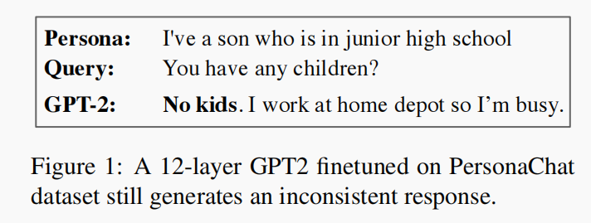
Introduction
the limited scale of annotated persona-dense data are still barriers towards training robust and consistent persona-based dialogue models.
Notes:
The PERSONA can be defifined as
a composite of elements of identity, such as profifiles
and background personal facts.
基于角色的对话会利用大量的与人物相关的数据，有丰富的任务特征，但是数据有限

Slide 3
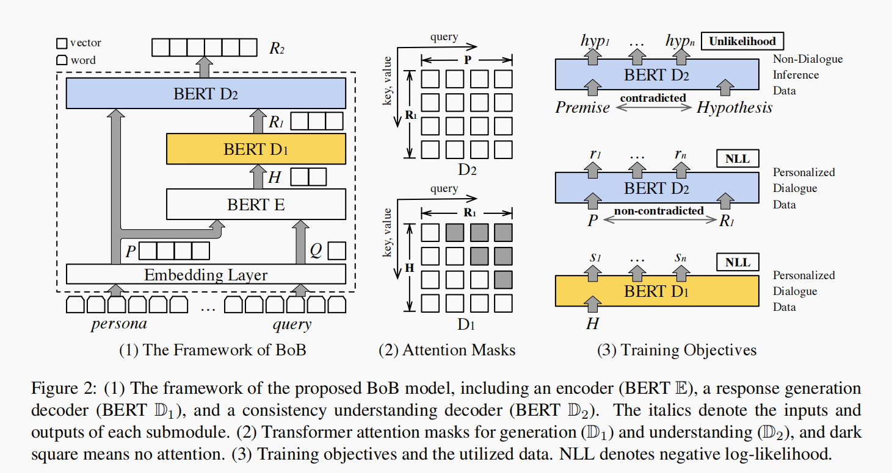
Method

Slide 4
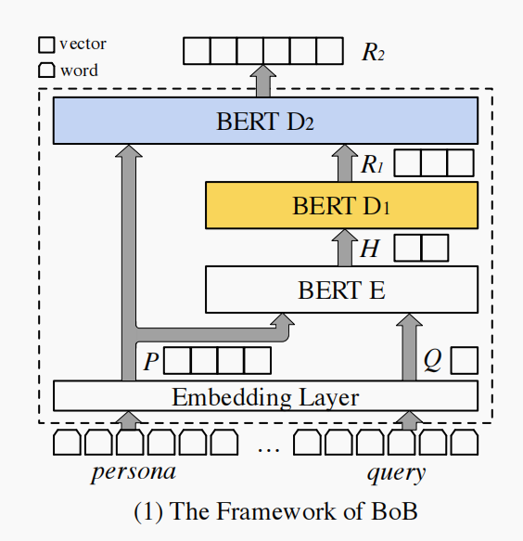
Method
Encoder

Slide 5
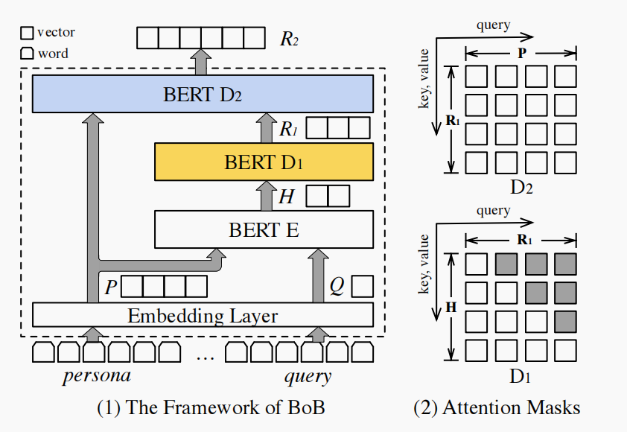
Method
Response Generation Decoder

Slide 6
Method
Consistency Understanding Decoder
Training Objectives

Slide 8
Method
Training Objectives

Slide 9
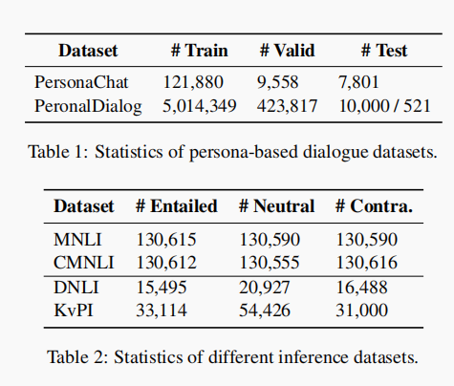
Experiments

Slide 10
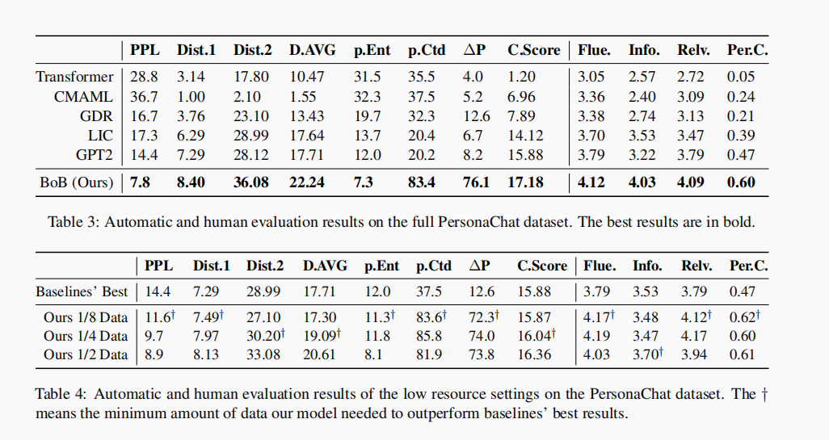
Experiments

Slide 11
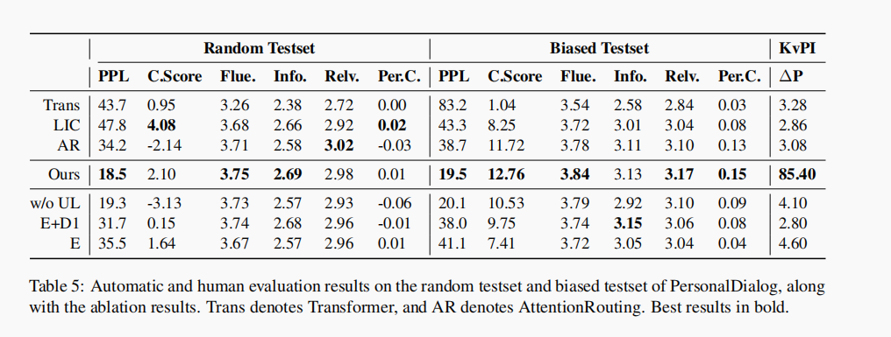
Experiments

Slide 12
Experiments

Slide 13
Thanks

